Slide 1


Build a Personalized Online Course Recommender System with Machine Learning
Sihan Wang
May 27th , 2025

Slide 2
Outline
Introduction and Background
Exploratory Data Analysis
Content-based Recommender System using Unsupervised Learning
Collaborative-filtering based Recommender System using Supervised learning
Conclusion

Slide 3
Introduction
Project background and context
E-learning platform in recent years has provide great educational opportunity to users. However, the abundance of available courses often overwhelm users for course selection. To increase user engagement and promote courses, course recommendation system is inevitable.
Problem states and hypotheses
1. Which recommendation techniques yield the most accurate predictions for future enrollments?
2. Which factors/feature is significant for recommendation system.
The hypotheses including users’ course rating, course popularity, course genre etc.

Slide 4
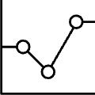
Exploratory Data Analysis

Slide 5
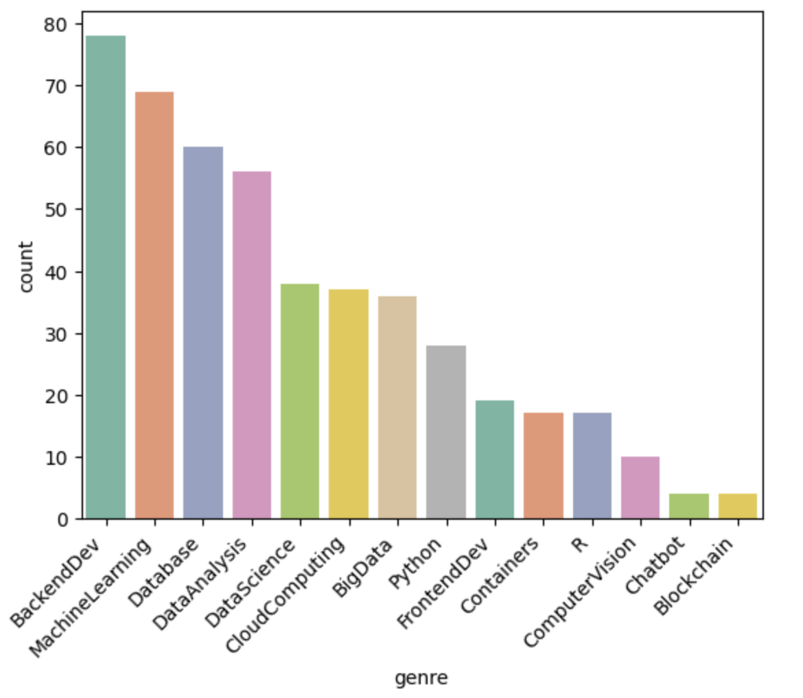
Course counts per genre
Backend development, machine learning, databases, data analysis and data science rank the top 5 in count.
Blockchain is the with the least count.

Slide 6
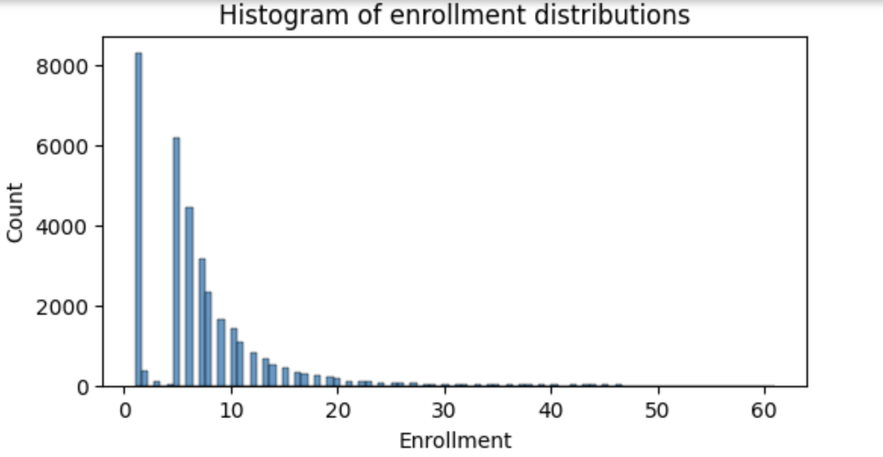
Course enrollment distribution
The distribution of enrollment is right skew. The majority enrollment is less than 20.
No users enroll above 60 courses.

Slide 7
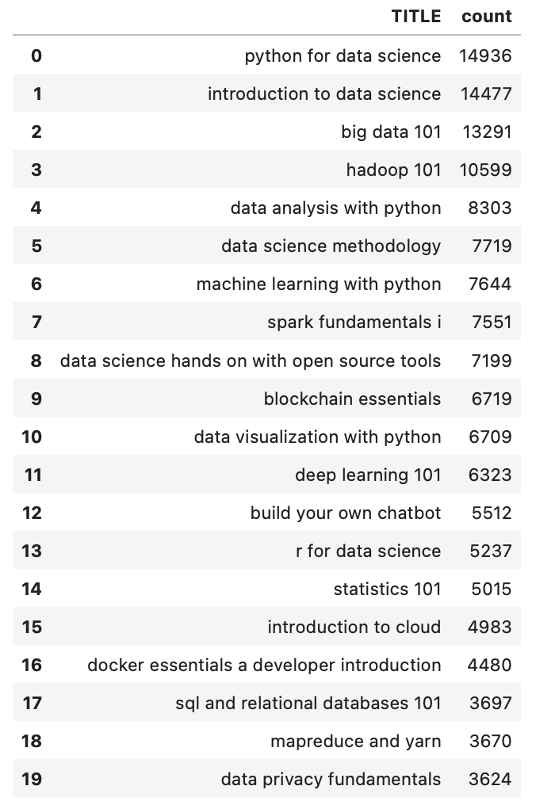
20 most popular courses
Python for data science is the most popular course with enrollment 14936. The second and third popular course are introduction to data science and big data 101 with enrollment also exceed 10,000.
Data science courses dominate the top 20 list.

Slide 8
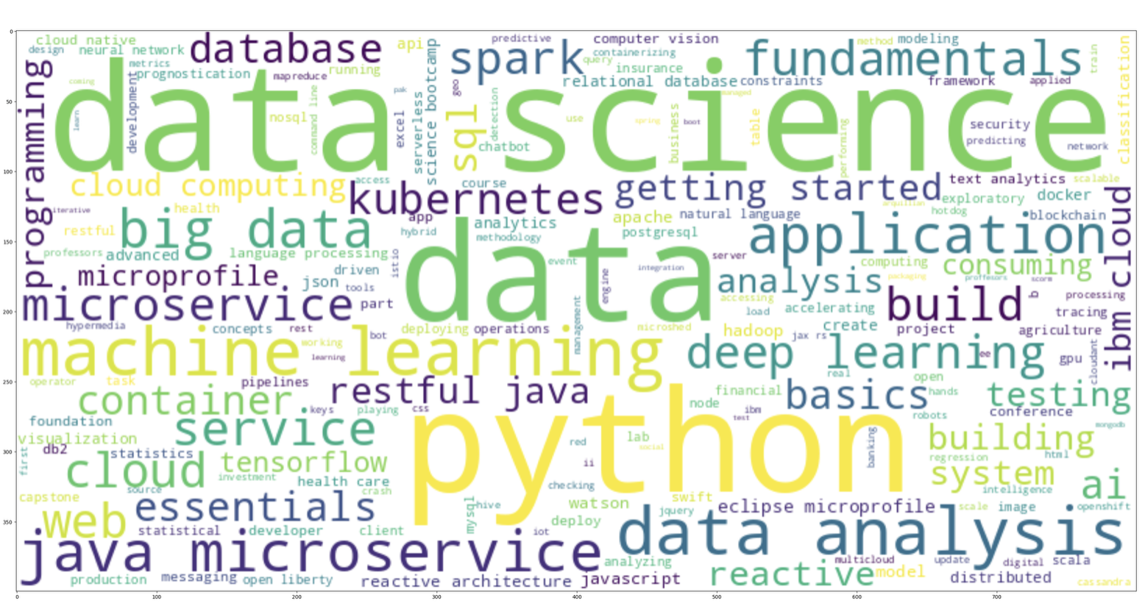
Word cloud of course titles
Based on word cloud, words like ‘data science’, ‘data’, ‘python’, ‘big data’, ‘machine learning’ are dominant topics.

Slide 9
Content-based Recommender System using Unsupervised Learning

Slide 10
Flowchart of content-based recommender system using user profile and course genres
Get user rating and course genre dataframe
1
Generate user profile by dot product of user rating and course genre dataframe
2
Get a list of unenrolled course for users
3
Get an unenrolled course genre matrix
4
Get course score (dot product of user profile with unrolled course genre matrix)
5
Use predefined threshold to filter courses for recommendation
6

Slide 11
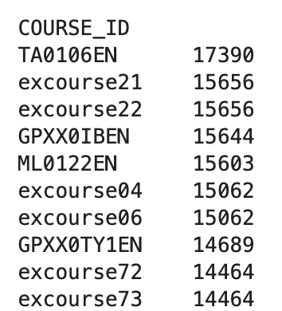
Evaluation results of user profile-based recommender system
Recommendation score = 10
On average, how many new/unseen courses have been recommended per user (in the test user dataset)
Round down to 68 courses.
What are the most frequently recommended courses? Return the top-10 commonly recommended courses across all users

Slide 12
Flowchart of content-based recommender system using course similarity
Calculate the similarity between two courses using Bag of Words (BoW) features.
1
Get user enrolled courses and unenrolled courses
2
For each enrolled course, find similarity score with each unenrolled course, set threshold for similarity.
3
Recommend courses with above similarity threshold.
4

Slide 13
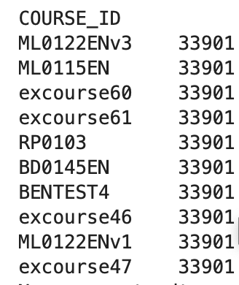
Evaluation results of course similarity based recommender system
similarity threshold = 0.4
On average, how many new/unseen courses have been recommended per user (in the test user dataset)
On average, 1 course has been recommended per user.
What are the most frequently recommended courses? Return the top-10 commonly recommended courses

Slide 14
Flowchart of clustering-based recommender system
Get user profile
1
Standardize user profile with mean as 0, std as 1
2
Find optimized cluster number K using grid search
3
Apply kmeans model with optimum cluster, assign cluster label to each user
4
find popular course for each cluster using enrollment data
5
Recommend user unenrolled courses that belong to user's cluster
6
Apply PCA if features are correlated

Slide 15
Evaluation results of clustering-based recommender system
Optimum cluster = 20
PCA component number = 14
Enrollment threshold = 100
On average, how many new/unseen courses have been recommended per user (in the test user dataset)
Round down to 5 courses.
(5.8 as output)
What are the most frequently recommended courses? Return the top-10 commonly recommended courses
Below shows top ten recommended course and total times of recommendation

Slide 16
Collaborative-filtering Recommender System using Supervised Learning

Slide 17
Flowchart of KNN based recommender system
Get users' rating for their enrolled courses, convert to user-item interaction sparse matrix
1
Using sklearn surprise library to split data into train, test
2
Train the model KNNBasic() using train dataset
3
Predict the model using test dataset
4
Evaluate model performance (eg. RMSE)
5

Slide 18
Flowchart of NMF based recommender system
Get users' rating for their enrolled courses, convert to user-item interaction sparse matrix
1
Using sklearn surprise library to split data into train, test
2
Train the model NMF() using train dataset
3
Predict the model using test dataset
4
Evaluate model performance (eg. RMSE)
5

Slide 19
Flowchart of Neural Network Embedding based recommender system
Load rating dataframe
1
Create RecommenderNet() class using Tensor flow Keras
2
Build one hot coding vectors for users and course items
3
split the encoded dataset into training and testing datasets.
4
Train the RecommenderNet() model
5
Evaluate model performance
6

Slide 20
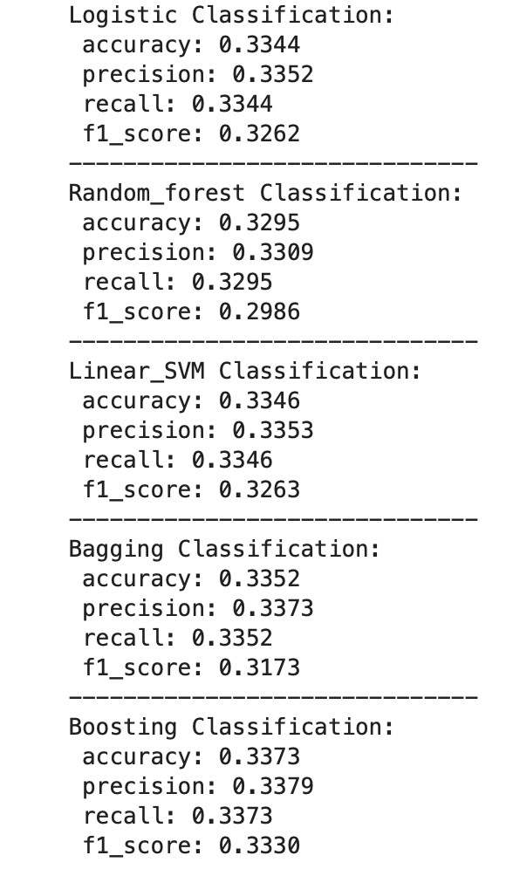
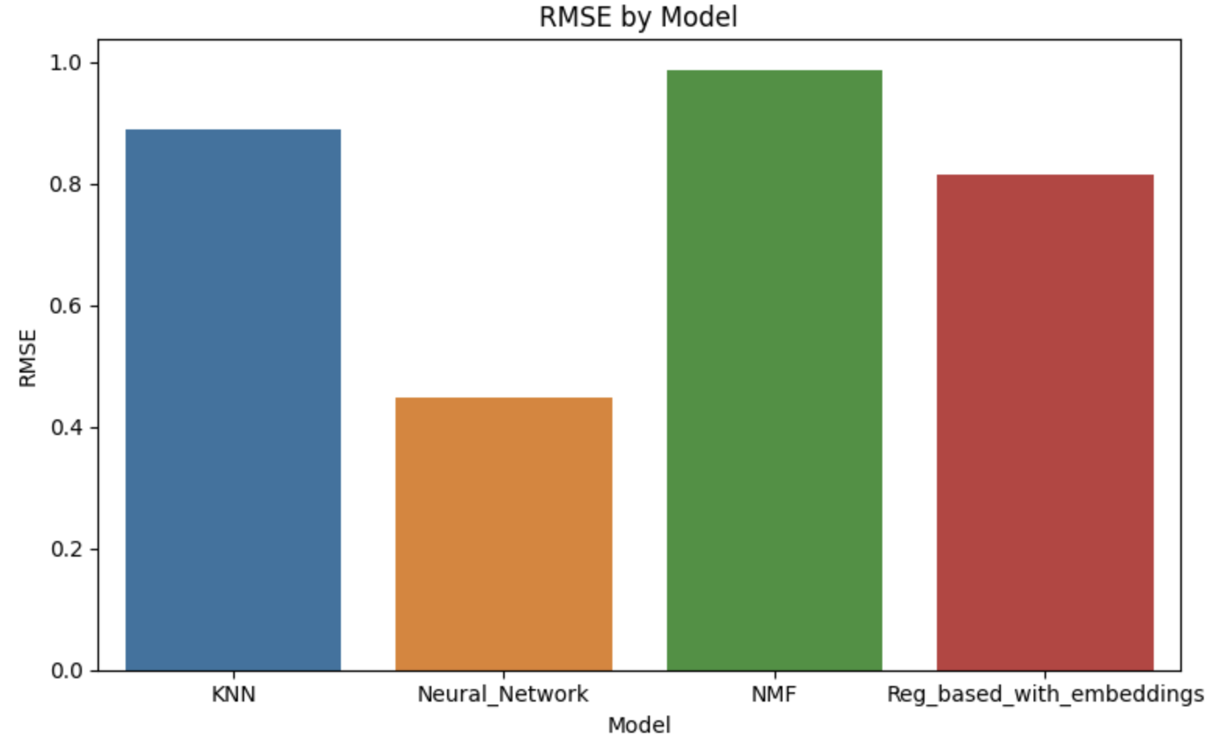
Compare the performance of collaborative-filtering models
Classification-based Rating Mode Prediction using Embedding Features¶

Slide 21
Conclusions
In this project, several approaches to enhance online course enrollment recommendations were explored. Multiple algorithms including:
Content-Based Filtering: recommends courses based on similarities in course content and unsupervised Kmeans model to group similar users.
Collaborative Filtering: use user-course interaction data to identify popular courses and suggest courses favored by similar users.
Course rating prediction: neural network, regression-based and classification-based using embedding features.
Evaluation metrics such as RMSE, precision, recall, F1-score, were used to assess the performance of each model.
Neural network didn’t outperform KNN, NMF may due to simpler models fits data better and avoid overfitting, or simpler model handle cold start better.
All classification-based predictions has low accuracy, with bagging and boosting are slightly higher than others.

